Slide 1



INTELLIGENT TRAFFIC MANAGEMENT SOLUTION
THROUGH THE IMPLEMENTATION OF GOOGLE MAPS AND ARTIFICIAL INTELLIGENCE
GROUP 8

Slide 2

INTRODUCTION
Traffic congestion is a major issue in urban areas, reducing average vehicle speeds and increasing pollution.
The Intelligent Traffic Management Solution (ITMS) leverages Google Maps and Artificial Intelligence (AI) for adaptive traffic control.
ITMS aims to optimize traffic signals and reduce congestion using real-time data.

Slide 3
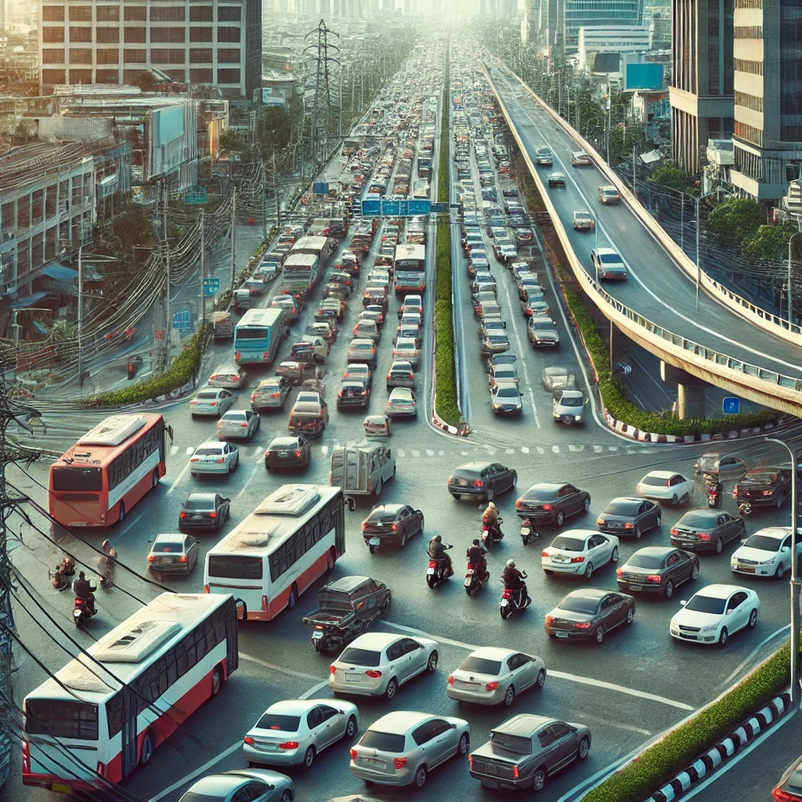
CHALLENGES IN TRAFFIC MANAGEMENT
High vehicle density leads to inefficiencies in traffic flow.
Poorly designed intersections and entry/exit points cause bottlenecks.
Static traffic light systems fail to adjust to real-time traffic conditions.
Need for sustainability in transportation.

Slide 4
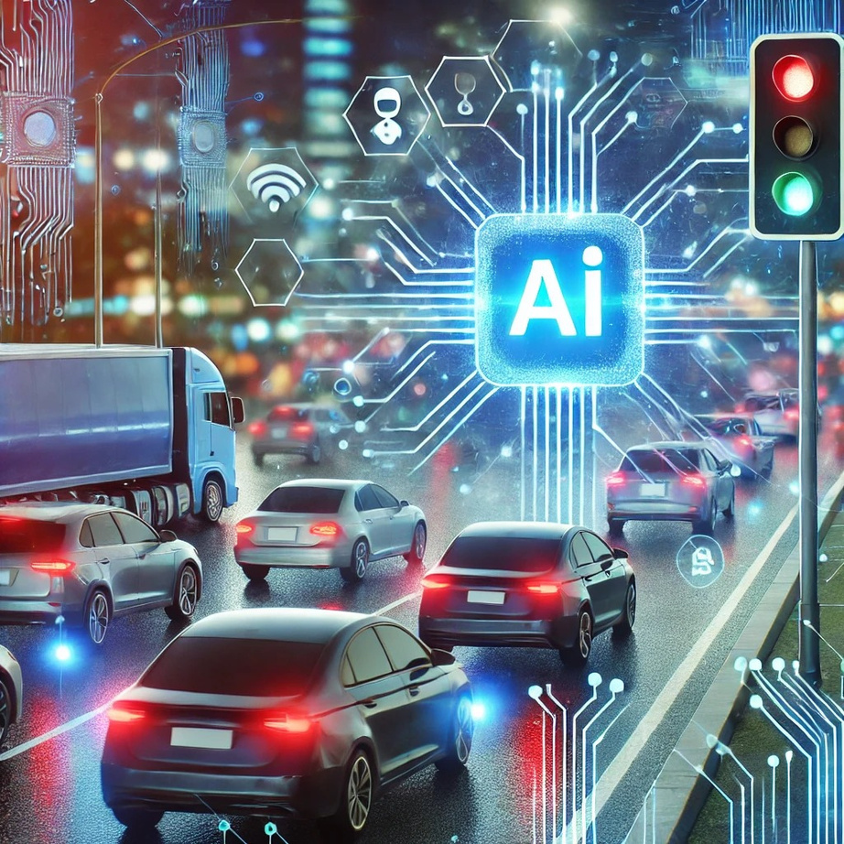
OVERVIEW OF ITMS
ITMS integrates AI and Google Maps to dynamically manage traffic signals.
Uses data from GPS-enabled mobile devices and connected vehicles.
Adjusts traffic lights based on real-time vehicle movement.
Aims to improve traffic flow, reduce delays, and optimize fuel consumption.

Slide 5
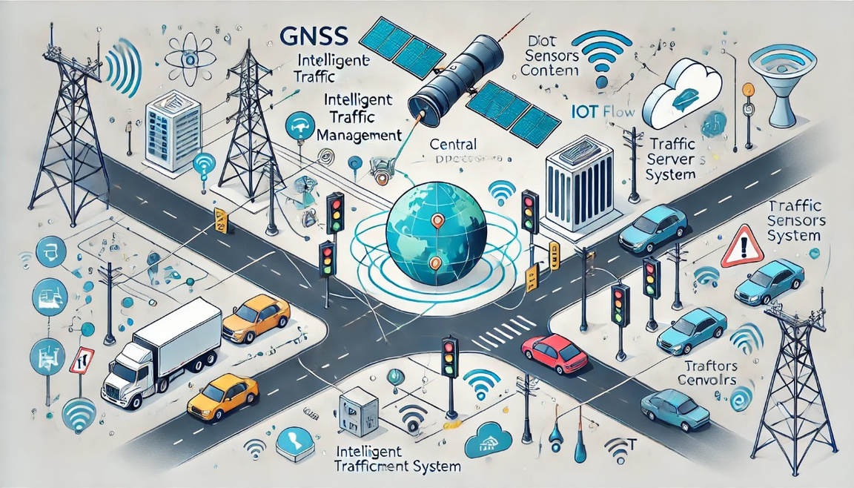
KEY COMPONENTS OF ITMS
GNSS Satellite Transponder: Collects vehicle location data.
Central Server: Processes real-time traffic information.
Traffic Signal Control Subsystem: Adjusts signals dynamically.
Local Radio Signal Emitters (RFID): Enhances vehicle tracking.
Alternative Internet Access Methods: Ensures continuous connectivity.

Slide 6
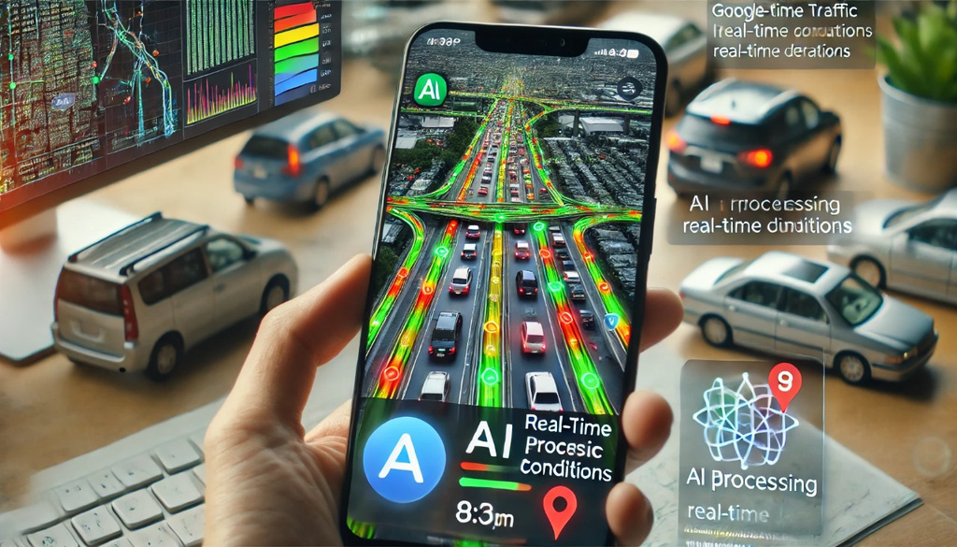
ROLE OF GOOGLE MAPS IN ITMS
Uses crowdsourced data from smartphones and GPS devices.
Monitors real-time vehicle speed and congestion levels.
Categorizes roads with color codes: Green (free-flow), Yellow (moderate congestion), Red (heavy traffic).
AI processes this data to adjust signal timings accordingly.

Slide 7
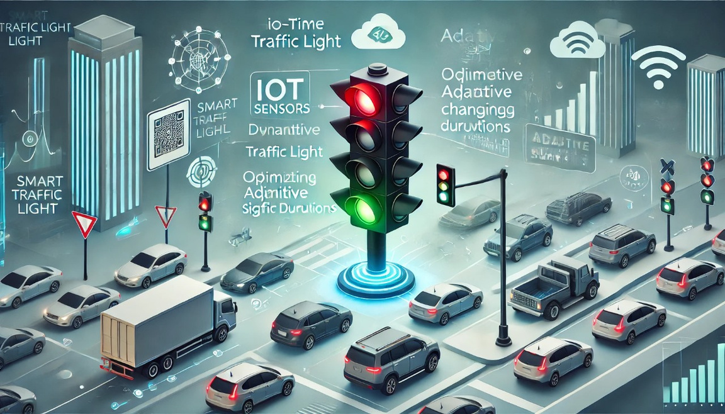
IOT-BASED ADAPTIVE TRAFFIC LIGHTS (IOTATL)
Differ from traditional traffic lights by using real-time vehicle position data.
Continuously monitors traffic patterns via GPS and IoT sensors.
Uses AI-based algorithms to dynamically adjust signal timing.
Reduces congestion by prioritizing high-density traffic areas.

Slide 8
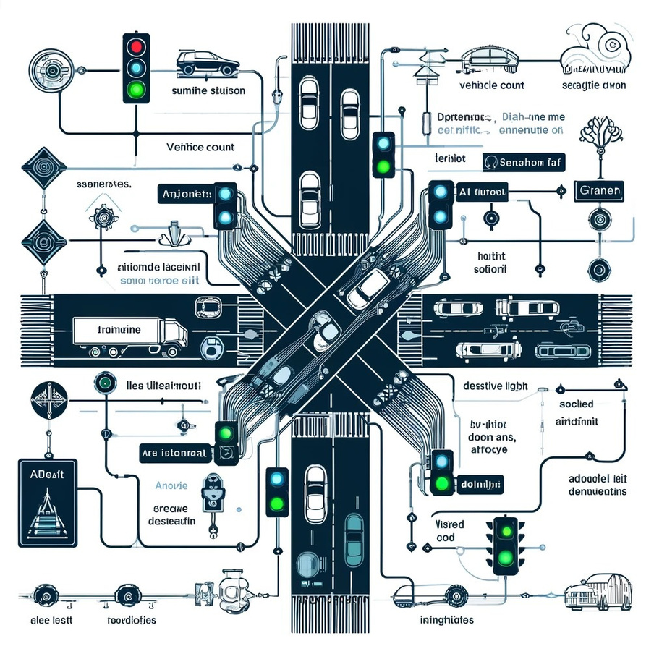
ADAPTIVE TRAFFIC SIGNAL ALGORITHMS
Mixed Adaptive Traffic Lights: Combines traditional and IoT-based traffic control.
Pure Adaptive Traffic Lights: Uses only GPS-based vehicle data.
Algorithms prioritize signal changes based on vehicle count and queue lengths.
Dynamic adjustments ensure smoother traffic flow.

Slide 9
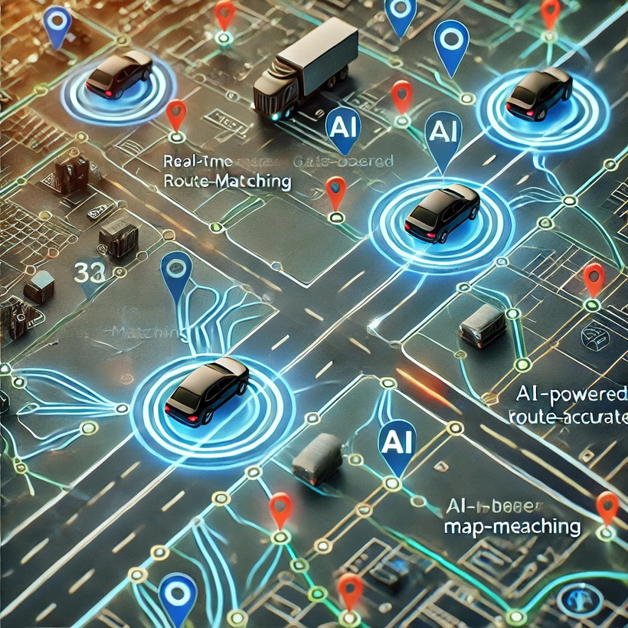
MAP-MATCHING ALGORITHM
Ensures accurate vehicle positioning on roads.
Considers vehicle trajectory, road curvature, and real-time speeds.
Helps minimize errors in traffic light adjustments.
Enhances overall efficiency of ITMS.

Slide 10
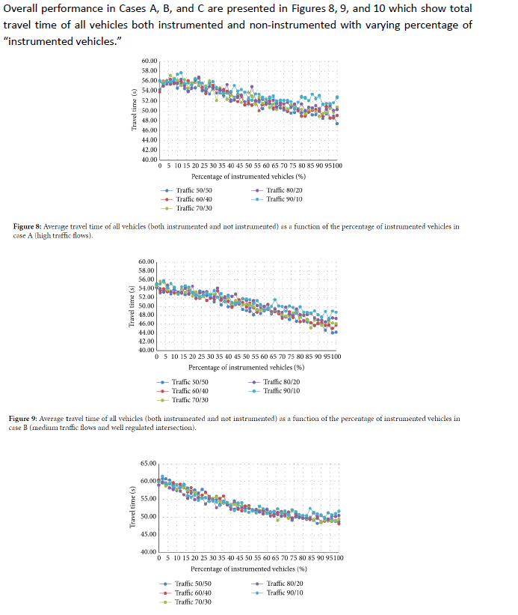
CASE STUDIES & RESULTS
Implemented in various traffic simulations.
Reduction in congestion by up to 35%.
Improved travel times by optimizing traffic light durations.
Higher fuel efficiency due to smoother traffic movement.

Slide 11
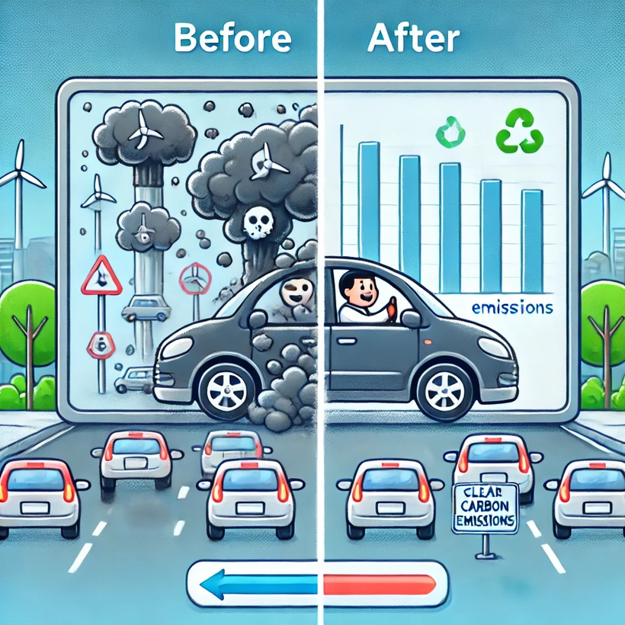
ENVIRONMENTAL & ECONOMIC BENEFITS
Reduced fuel consumption due to decreased idling time.
Lower carbon emissions, contributing to environmental sustainability.
Improved road safety and reduced stress for drivers.
Potential revenue generation through smart tolling systems.

Slide 12
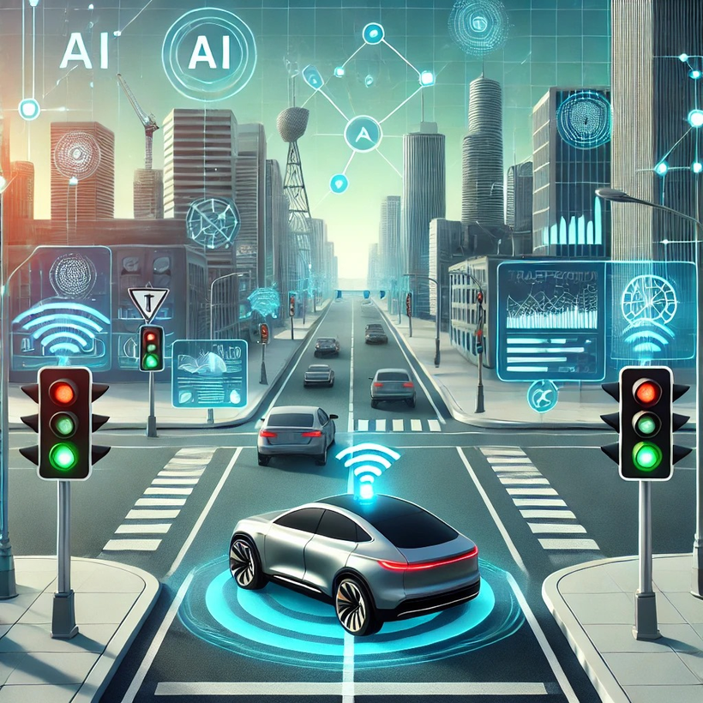
FUTURE ENHANCEMENTS
Integration with autonomous vehicles for smarter traffic management.
AI-powered predictive traffic analysis for better planning.
Use of machine learning to continuously optimize traffic patterns.
Expansion to public transportation systems for seamless connectivity.

Slide 13
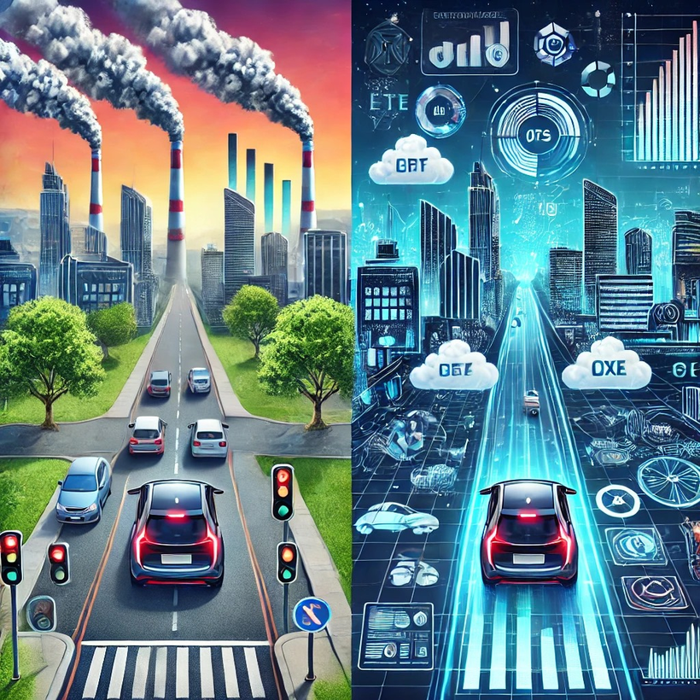
CONCLUSION
ITMS presents a revolutionary approach to urban traffic management.
Utilizes real-time data and AI for adaptive traffic control.
Significantly reduces congestion, fuel wastage, and pollution.
Encourages smart city development and sustainable urban mobility.

Slide 14

THANK
YOU

